Slide 1
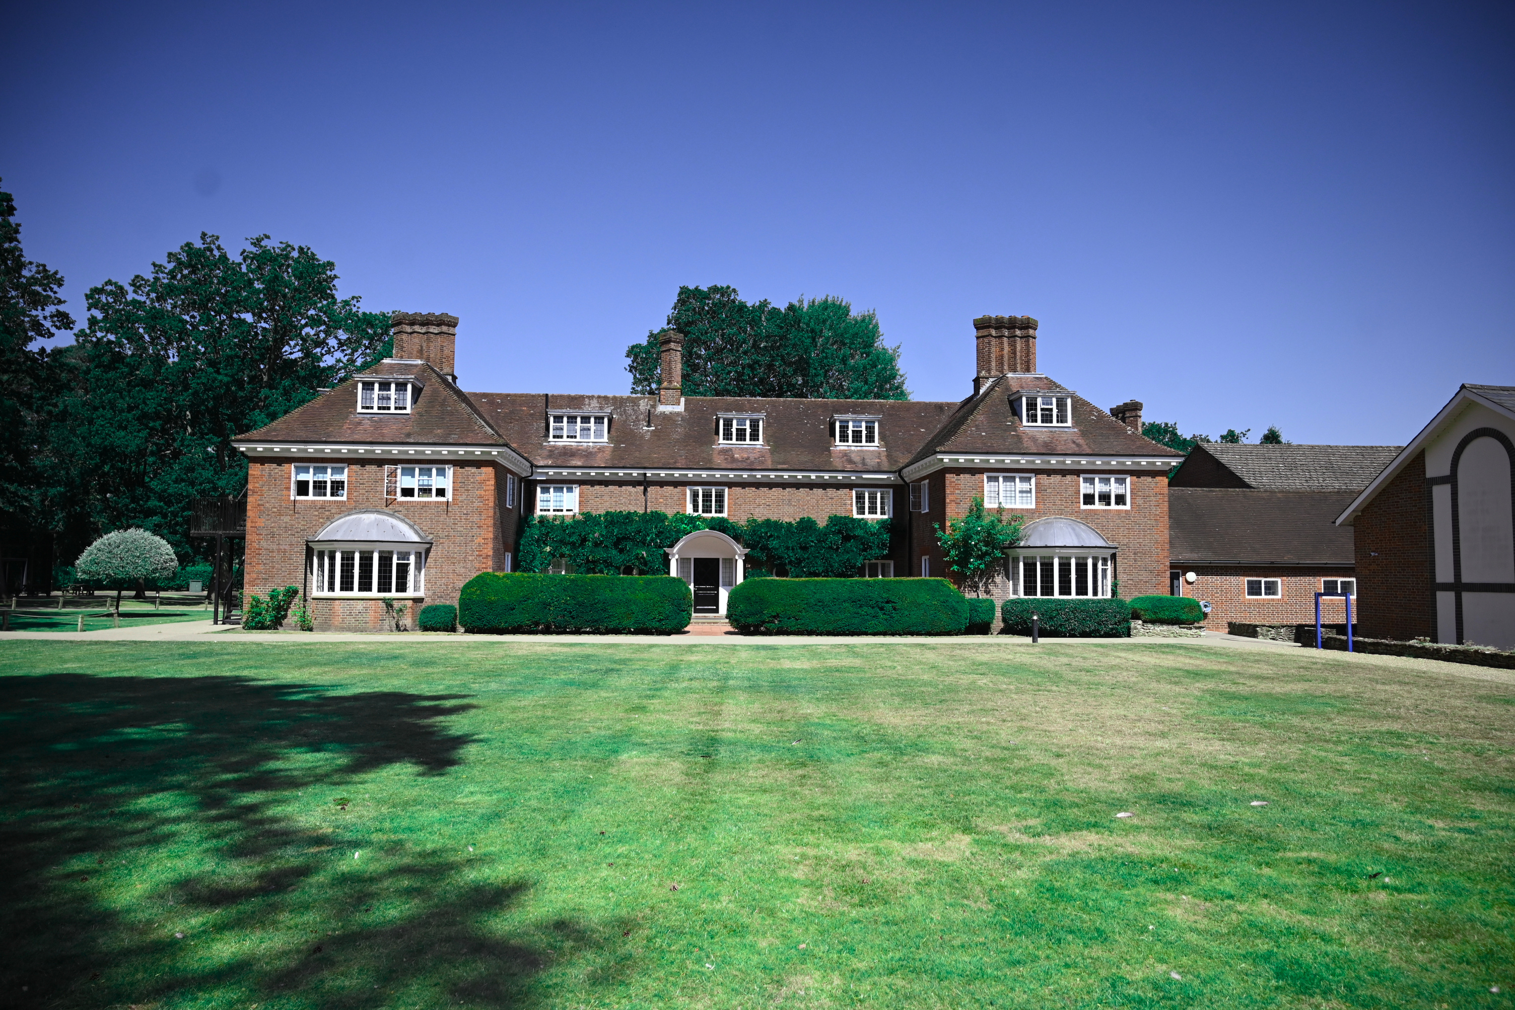


LUCKLEY HOUSE SCHOOL
WHAT THE GOOD SCHOOLS GUIDE SAYS

Slide 2
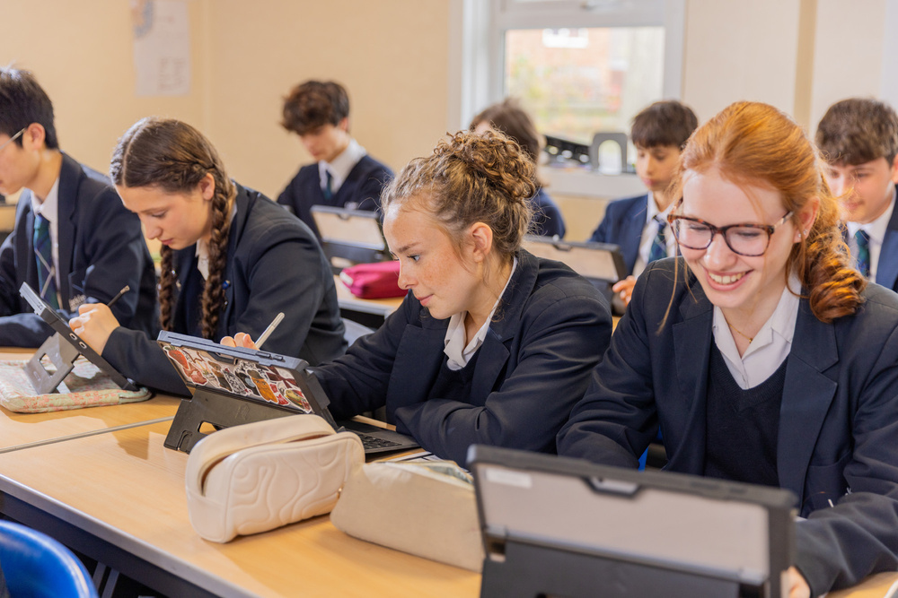
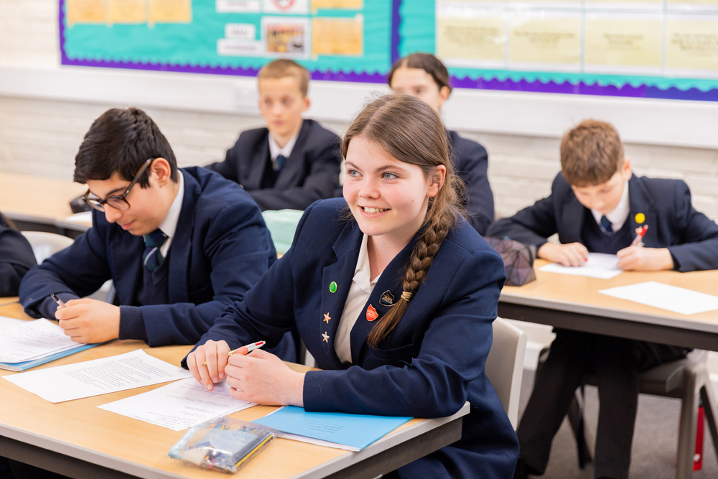
The Good Schools Guide is one of the UK's most respected and trusted independent resources for parents seeking information about schools. Established almost 40 years ago, it provides honest, impartial reviews of thousands of state, independent, boarding and international schools, helping families make informed decisions about their children's education.
Unlike many other school directories, The Good Schools Guide is entirely independent. Schools cannot pay to be included, excluded or receive favourable reviews, ensuring that every assessment remains unbiased and credible. Reviewers visit schools, speak with headteachers, staff, pupils and parents, and produce detailed reports that offer an authentic insight into each school's character, strengths and areas of focus.
Alongside comprehensive reviews, the guide provides valuable information including academic performance, inspection reports, boarding provision, extracurricular opportunities and pastoral care. Parents can also access performance data and compare schools to find the best fit for their child's needs and aspirations.
In addition to its independent reviews, many schools create professionally designed profile pages that showcase their facilities, ethos and achievements. These pages complement the editorial review by providing prospective families with a visual insight into school life.
Today, The Good Schools Guide continues to be a trusted source of educational advice, supporting families in making confident, well-informed choices about their children's future.

Slide 3
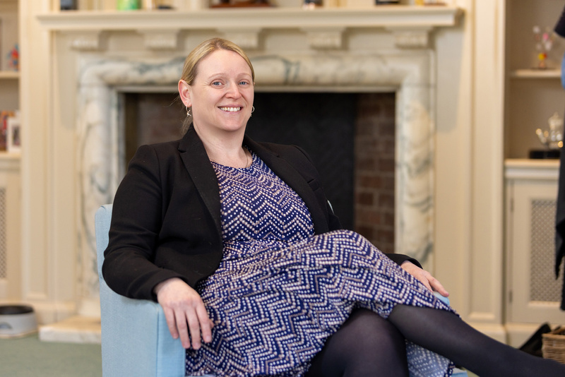
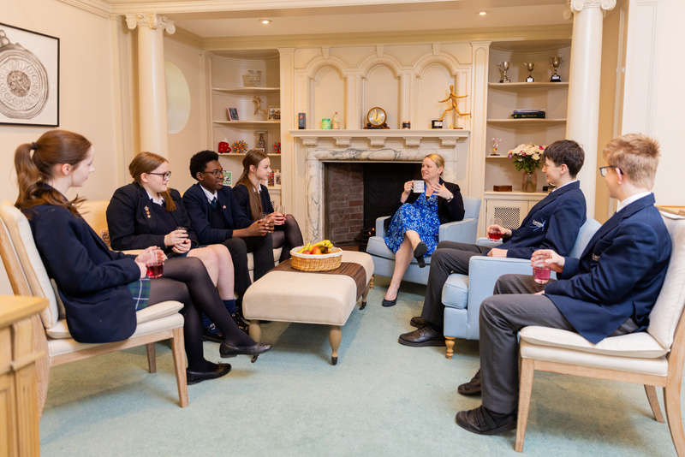
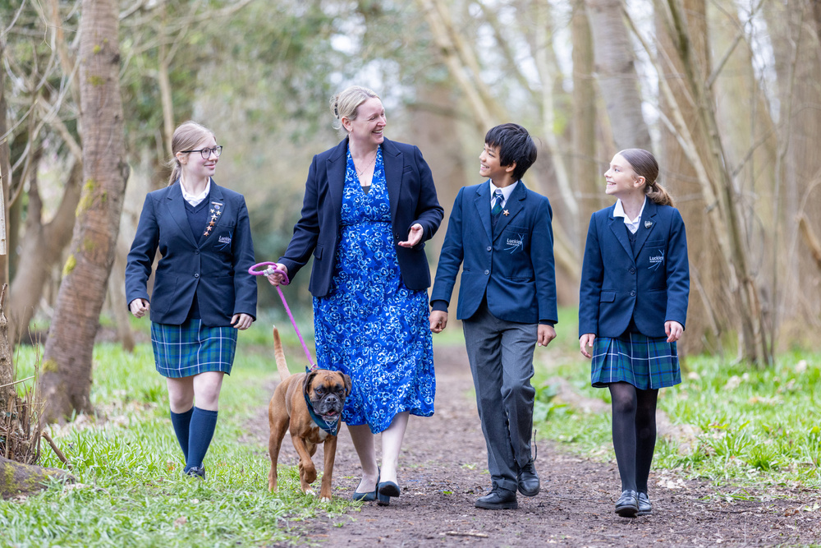
THE HEAD
Students are big fans too, with countless tales of help with coursework and congratulatory notes. Beloved Boxer, Copper, accompanies her everywhere with bounding energy and muddy paws (‘a nightmare for school carpets but adored by everyone’) and makes herself at home in her cosy office with windows overlooking bluebell woods, where pupils stop by to wave or say hello. It is a calm, relaxed space mirrored by its down-to-earth incumbent, whose thoughtful, brisk way of speaking exudes common sense and a deep love for her school - ‘the culture, the camaraderie, the calibre of young people’.
Since December 2025, Claire Gilding-Brant BA and QTS (PE from Brighton) MA (education from Reading).
Currently undertaking doctoral research. Started teaching at Oxford High School, moving to St Piran’s, then director of sport at Bruton. Joined Luckley in 2010 as head of PE, becoming head of sixth, senior deputy and latterly interim head.
Parents are delighted at ‘Mrs GB’s’ appointment, praising the ‘seamless transition’ and her ‘perfect mix of discipline and friendliness’. They love that she is ‘hugely visible’ at events – most recently all four nights of ‘brilliant’ Beauty and the Beast production – and that she ‘treats parents as an important part of the school’.
Her priority is ‘to ensure children are not impacted by any sector challenges - you have to love school; it should be brilliant’. Large jar of sweets on the mantlepiece no doubt helps.
She recently ran the London Marathon, which ‘took over her life’, and in the past she has also been an avid county and national hockey player – ‘now just the occasional friendly’. Married to James, she splits time between onsite home and their house in the rolling Chilterns, where they can be found walking Copper, boating and clay pigeon shooting.
Beloved Boxer, Copper, accompanies her everywhere with bounding energy and muddy paws (‘a nightmare for school carpets but adored by everyone’)

Slide 4
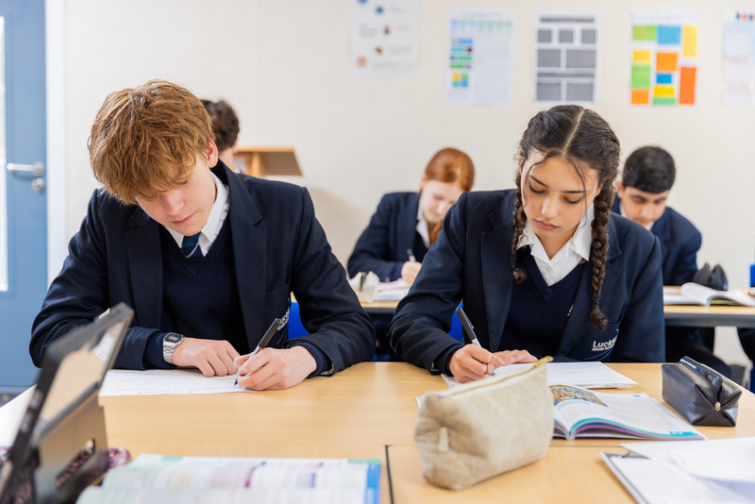
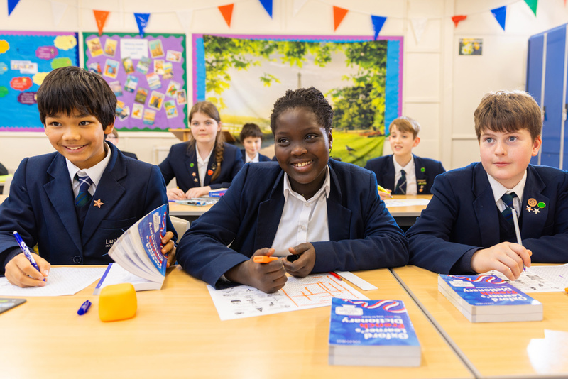
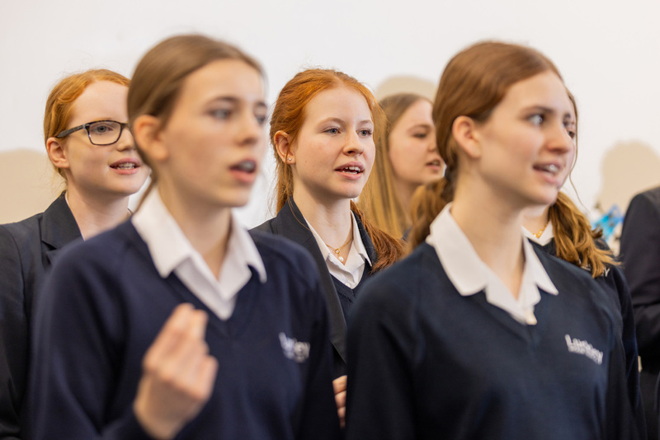
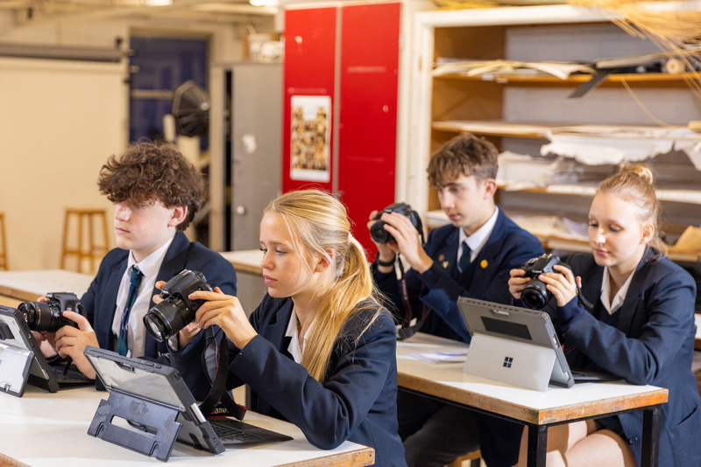
ENTRANCE
EXIT
Around half leave after year 11, to a range of strong local state sixth forms. Vast majority of sixth formers go to university, almost half to Russell Group. Bristol, Warwick, Reading, Southampton, Royal Holloway and King’s College London most popular recently. One to competitive Christie’s apprenticeship programme. One medic and one to Oxbridge in 2025, but average is seven per cent of the cohort. A handful of gap years.
TEACHING
‘Lightly selective’, with entrance via cognitive ability tests and interview with head for the 40 places in year 7 and around 20 in year 9. Year 7 applicants also create a personal storyboard about their hobbies, with additional language exam for international applicants. Pupils arrive from 20+ primaries and preps - largest cohorts from St Neot’s, Waverley, Holme Grange and local state primary Evendons.
Between 10 and 15 join the sixth form from local schools – they need at least six grade 6s at GCSE including in their chosen A level subjects (7s for maths and sciences). Taster days available. Open days are in March, June and October.
A nurturing approach with small classes – capped at 20 and as low as three in some we visited. Setting in core subjects. Parents say teachers are ‘dedicated to the children and their subject’, with one telling us her child is ‘doing better at maths than ever since joining’ because they are so ‘friendly and patient’. Lessons mostly focused and upbeat – no mean feat in exam season. Pindrop silence in a year 7 English lesson, with 15 students ‘upgrading their sentences’ by writing letters, whilst a charismatic maths teacher had 18 year 9s laughing finding the gradient of linear graphs. Cheery languages teacher oversaw an accomplished student speaking French for as long as they could in preparation for upcoming MFL speaking exams to the delight of his peers. Majority use devices (school provides Surface tablets).

Slide 5
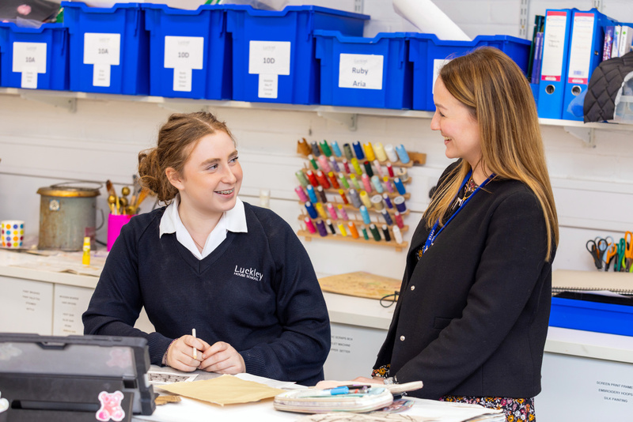
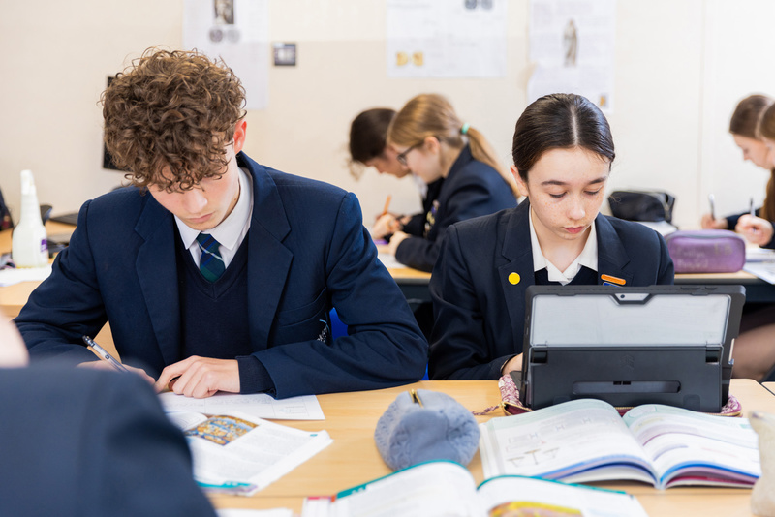
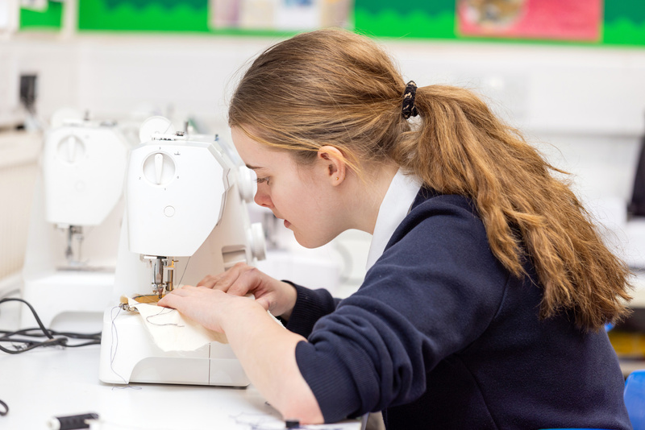
LEARNING
Well-equipped science block includes biology lab brimming with plants and full fish tank. Our tour guides described in stomach-churning detail their many dissections and we watched a focused year 9 lesson on sensory, relay and motor neurones where students diligently took notes. Practicals at least once a fortnight. Choice of French or Spanish from year 7. Everyone takes at least one language for GCSE (where Mandarin is also available), along with ‘strongly encouraged’ humanities and two other options (so that’s nine GCSEs in total). Best performers are food tech, DT and RS. Most popular are business, history and PE. Lessons mostly focused and upbeat – no mean feat in exam season.
accessibility software for support with texts. One-to-ones available (at additional cost) via parental request or school recommendation. Two thirds of students have access arrangements. Internal assessment available. Wheelchair access can be challenging in some buildings, but adjustments can be made where needed - lifts in Jubilee building and Drake Hall. EAL is under five per cent. Intensive support is ‘rarely needed’, but for available for short-term international students as part of their boarding package.
0.53%
Students with a SEN EHCPView all data
38.73%
Students with SEN supportView all data
LEARNING SUPPORT & SEN
Large proportion of SEN – 36 per cent on the register when we visited. Two EHCPs. Dyslexia is the main need, followed by ADHD and autism. They are supported by full-time SENCO (new to post), plus deputy, five specialist teachers and an LSA. Most parents told us of ‘great links to teaching staff’ and ‘positive and totally confidential support’; one told us ‘queries can be left open-ended’ - school says they are in the process of following up. Students report ‘incredible support, particularly during study leave’. No in-class interventions, but they have recently introduced ‘hugely helpful’ accessibility software for support with texts.

Slide 6
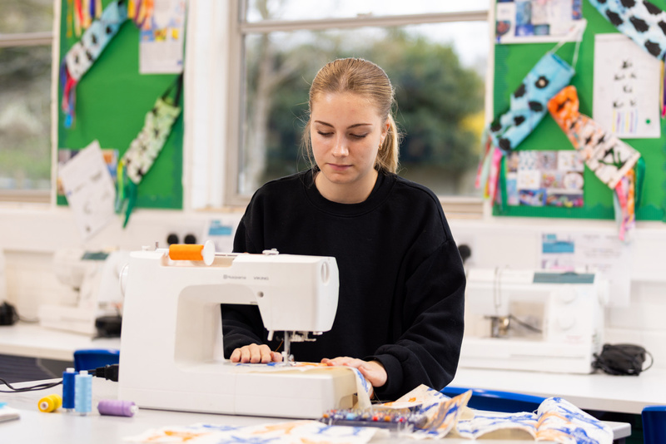
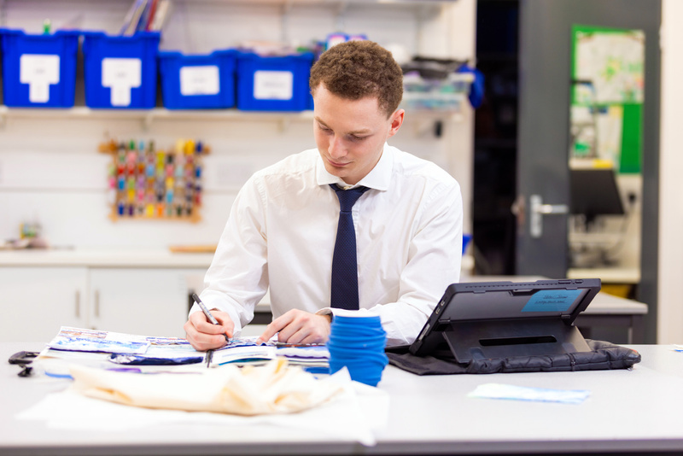
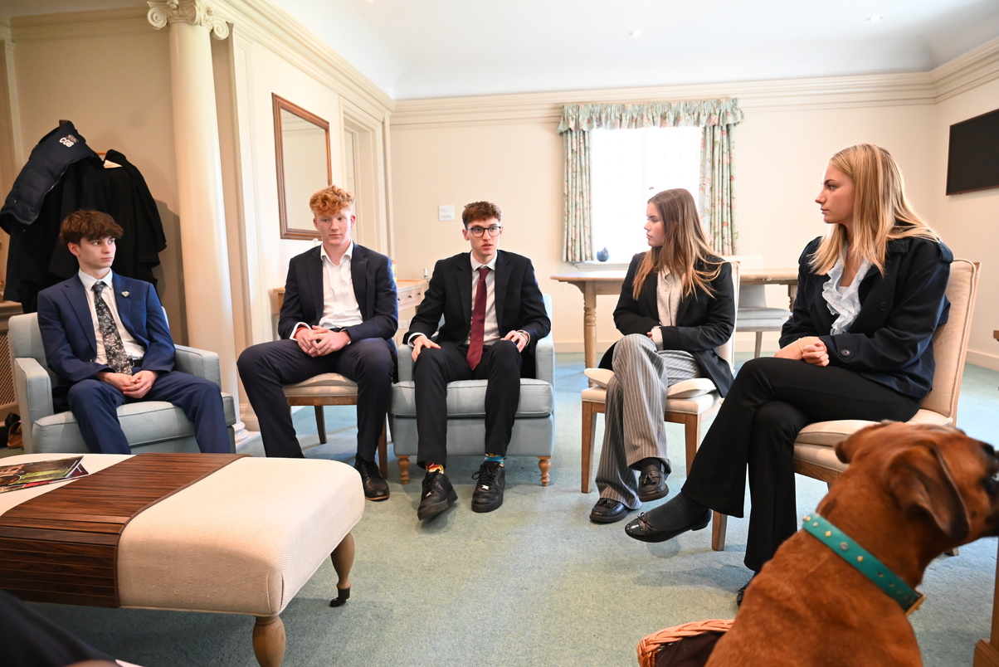
SIXTH FORM
Well-stocked sixth form study area is located above the school library. Noisy on our visit due to a lesson taking place below, but students were unperturbed, headphones in. Neighbouring student kitchen smelt invitingly of fresh toast and students enjoyed the packed common rooms and sunny conservatory. One student described the setup as ‘a sixth form family’ with ‘amazing teachers who know you inside out’.
Support for UCAS ‘incredibly good’, say students – several raving about the help with personal statements and university and course choices.
Careers programme also offers placements across hospitals and medical practices, plus work experience in an impressive range of fields. Plenty of fun too, with recent RAG week seeing teachers duct-taped to walls for charity. Sixth form-specific trips to Alton Towers, Edinburgh and Disneyland, plus a range of universities, most recently Cambridge, Durham and LSE. Popular ‘student suppers’ an innovative means of culinary preparation for university – recent butter chicken tutorial a hit.
Again, small classes – ranging from a handful to 18. ‘Can feel like private tutoring,' our sixth form guides tell us. Twenty A level subjects offered – all traditional, nothing unusual. Best performing are RS, classics and politics. Most popular are maths and psychology (by some margin) and biology. Year 12 and 13 combined to maintain breadth of offer. We watched head of sixth teaching a relaxed psychology lesson to a class of 17 – exploring a recent mock exam paper in depth. Most take three subjects; around 60 per cent do EPQ.

Slide 7
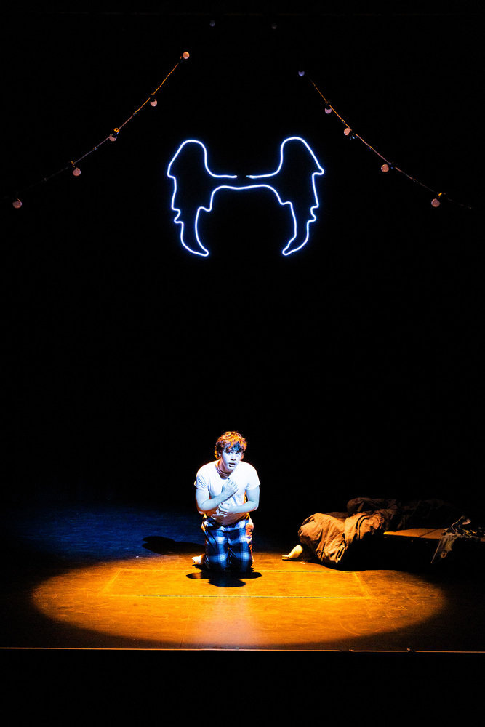
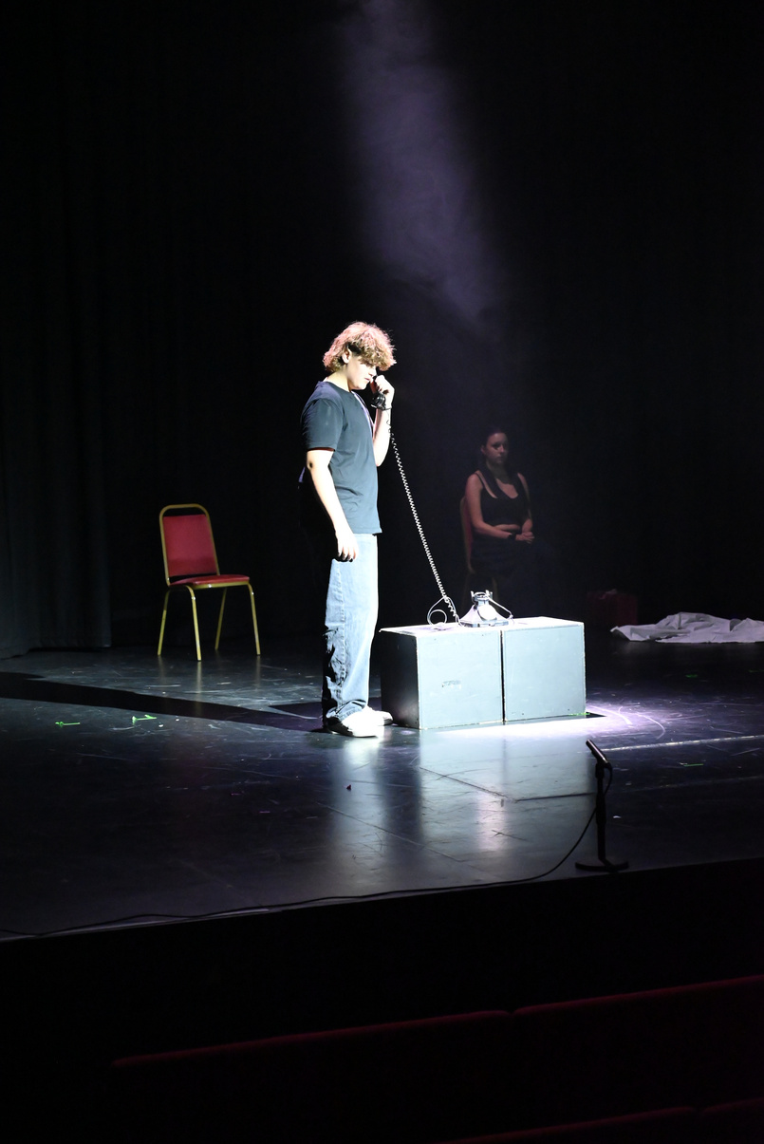
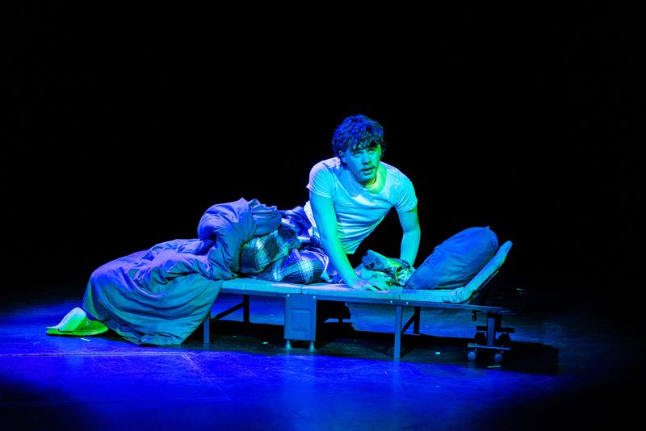
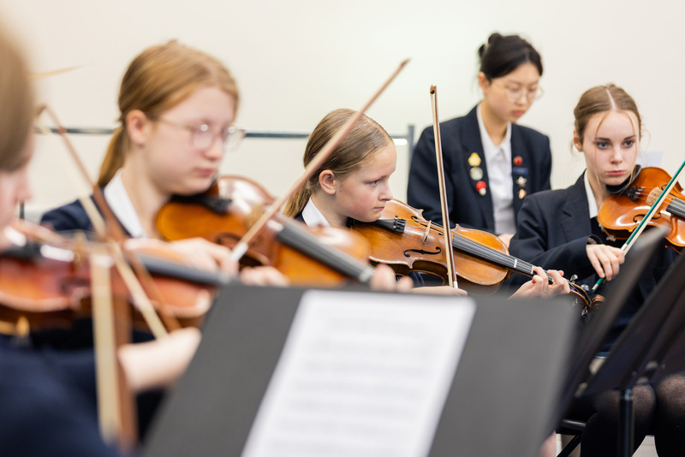
ART & EXTRA-CURRICULAR
Superb facilities and excellent reputation for the arts, with many parents citing this as the reason for sending their creative children here.
Snazzy music centre has acoustic-enhancing ceiling. Here, we saw year 13 musicians discussing textural elements of Indian classical music and later, the school acapella group rehearsing extraordinary Poker Face and Sweet Dreams mashup – one of five vocal groups, with music scholars, chamber choir, range of choirs and ensembles, full orchestra and swing band. Recording room and music tech suite well-kitted out – students recording their coursework said there’s lots of encouragement to get stuck in.
Parents say drama is ‘off the scale’, with ‘countless productions’ – most recently ‘West End standard’ Beauty and the Beast. They are lucky to have a full-size Whitty Theatre onsite. One told us her son ‘who doesn’t enjoy performing’ is now ‘a drama scholar, having thrown himself in behind the scenes with lighting, set design and sound’. We are told ‘everyone gets involved’ in the productions, ‘even the rugby lads’ – and a quarter do LAMDA, with others going for National Youth Theatre auditions. School recently hosted ISA Shakespeare monologue competition.
Plenty of opportunities to perform, including recent scholars’ concert and Luckley Young Singer of the Year competition. Around 40 per cent of students learn an instrument, vocals or musical theatre.

Slide 8
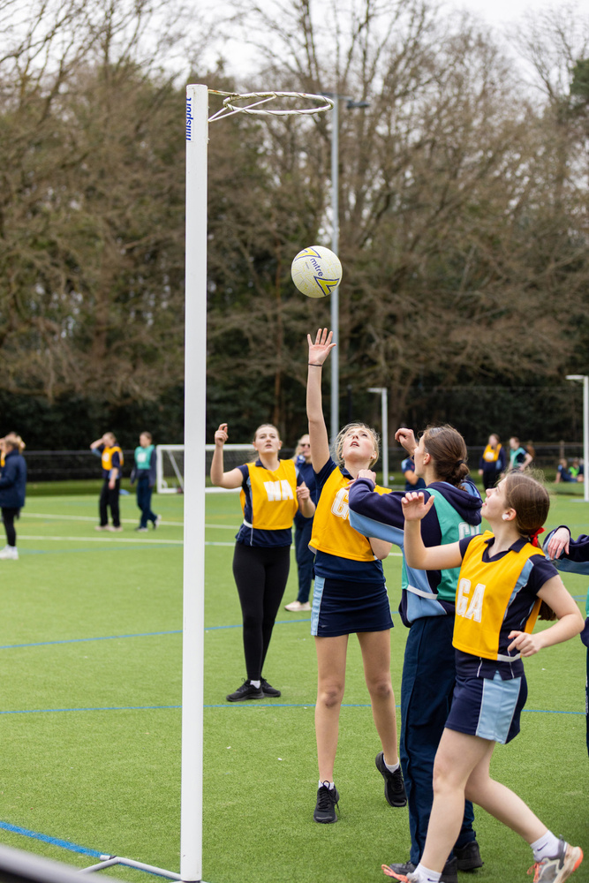
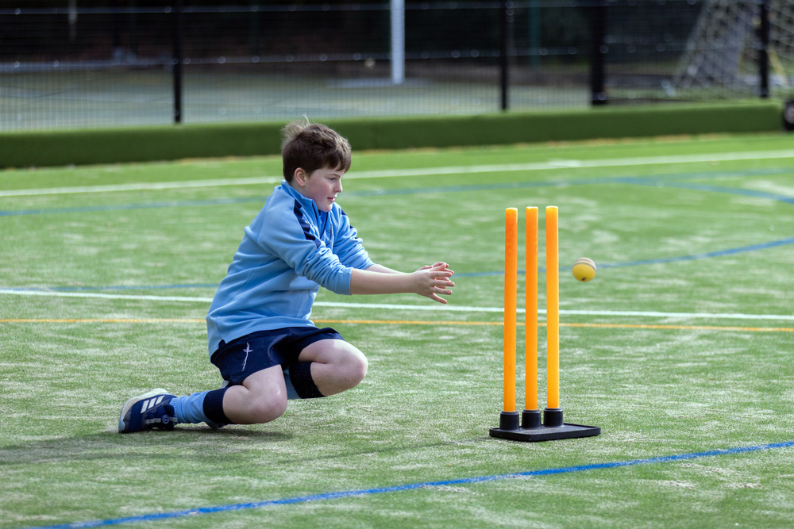
SPORT
A broad offering for art and design right up to A level, with plenty of awe-inspiring displays – including a centurion helmet piece drying in the sunshine on our visit, and large oil paintings filling the walls of the light-filled studios. Easels everywhere, and there’s photography provision including dark room. Students ‘love use of studios outside lesson time’, we are told. Art is taught in a carousel with DT and textiles in Key Stage 3, with ‘lots of encouragement for creativity and individual expression’. ‘Everyone can be an artist here,’ said a student. Woodwork creations in no short supply. Dog beds, desks and storage units caught our eye – and we enjoyed a fact-filled GCSE lesson taught on traditional woodwork benches. Food tech a favourite for many, with strong uptake at GCSE.
Around 50 clubs run at lunchtimes and after school. Everything from specialist DT to candle making and scuba diving. CCF from year 9 and DoE bronze, silver and gold, with around a quarter of students doing one or other (or both). Breakfast club, supper and supervised prep offer - day students can join boarders for daily fee. Plenty of international trips including cultural and sports tours to America, South Africa and Spain, annual ski and languages trips and residentials to Swanage and Iceland.
Sport is high on the agenda, with plenty of keen players and fixtures, but head acknowledges that lack of space means matches are usually played off-site or away. Plans in progress for expansion include adding pavilion and pitches, with students looking forward to benefiting from the home field advantage. Plenty of other facilities including fitness suite, trampolines, full-size climbing wall, MUGA and sports hall, plus 4G Astro. Swimming offered via local leisure centre, a 10-minute walk away. Cricket, football, hockey, basketball, badminton and athletics the main sports, with huge range of extracurricular. Mirrored studio for dance.
Some say the smaller sports offering has been to their advantage, one telling us her child was ‘not picked for much at previous schools but played in everything here’, others that their previously non-sporty child is now ‘rocketing in confidence’. Some parents told us the school sometimes calls on older or younger players to fill out numbers in teams, which can be a ‘bit of a letdown if you’re very competitive’. Parents praise ‘excellent athlete development programme’, offering sports scholars specialist sessions with partners MoveHQ gym.

Slide 9
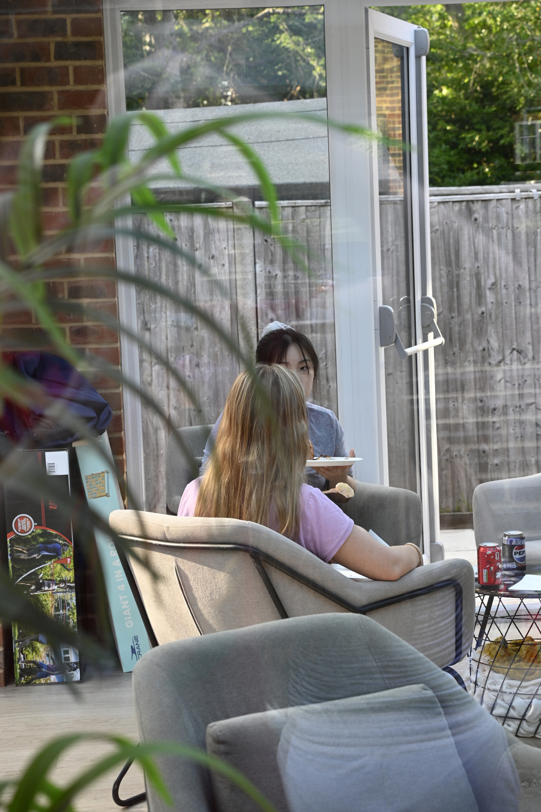
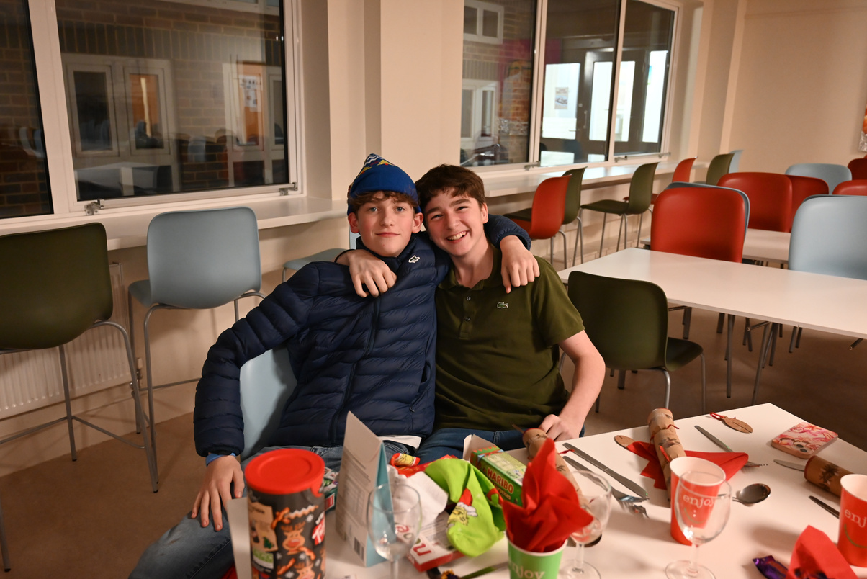
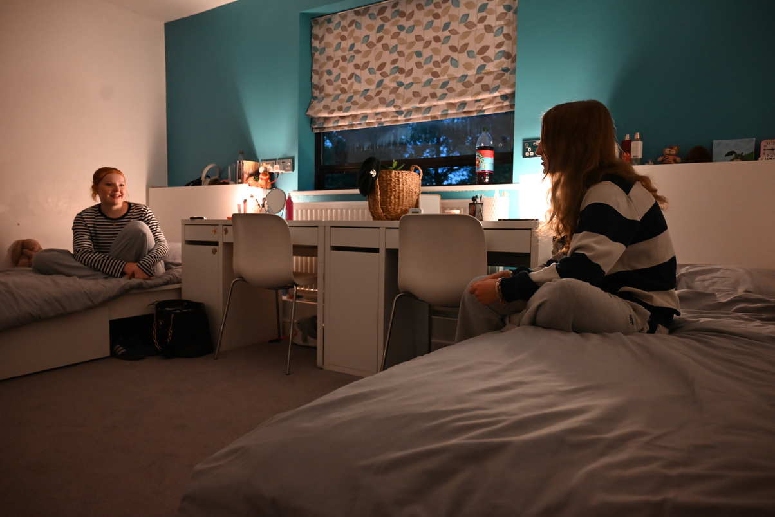
BOARDERS
Up to 40 places, two-thirds full on our visit. Fairly even split between weekly, full and flexi. Slightly more boys than girls. International boarders from South Korea, Nigeria, Hong Kong, Iran, Germany and France – around 50 per cent of intake. Handful of short-term international boarders.
Two boarding houses. Years 7 to 11 dorms above the sixth form centre, sixth formers sleep above the main house. Fifteen dorms (mostly doubles) across both – all minimalist, with relatively few personal touches. Modern sinks, wardrobes and desks in each room. Students appreciate the communal areas and ‘small and friendly’ houses. Facilities include smart games room, woodfire pizza oven and table tennis tables. No access to dorms during the day. Bert the boarding dog oversees all comings and goings.
Head of boarding’s wife is (handily) a paediatric nurse, with medical centre staffed by two counsellors and two nurses. ‘A fun atmosphere’, say students. ‘Rules to follow but plenty of trust.’ They can walk into town in pairs and houseparents often do a minibus run to ‘the big Tesco’ for snacks. Busy weekend schedule offers choice of at least one activity weekly – recent favourites the world’s longest slide and golf range. No Saturday lessons, but daily prep compulsory. Students were excited for weekend barbeques during our visit.

Slide 10
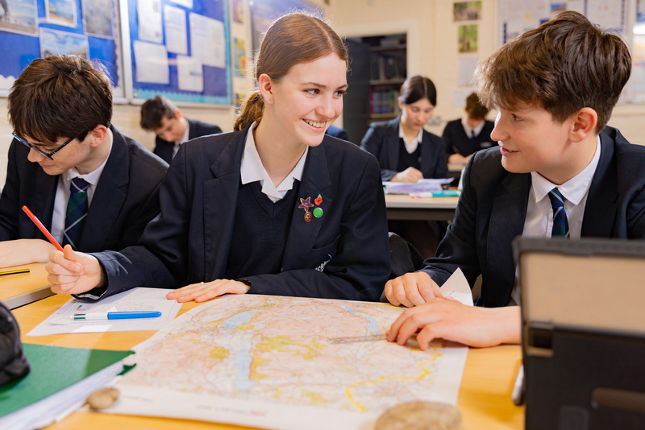
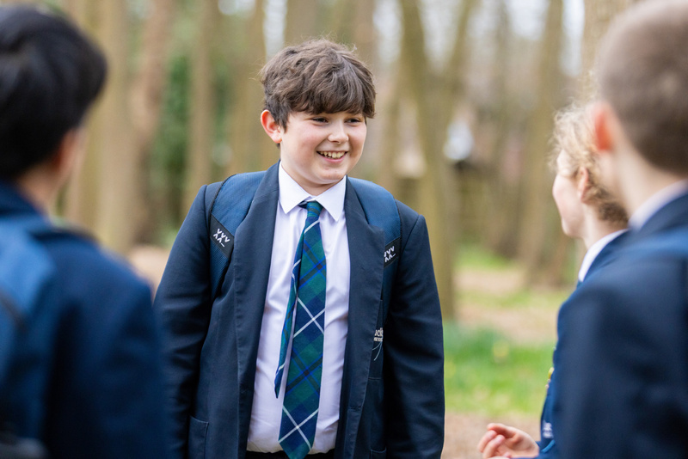
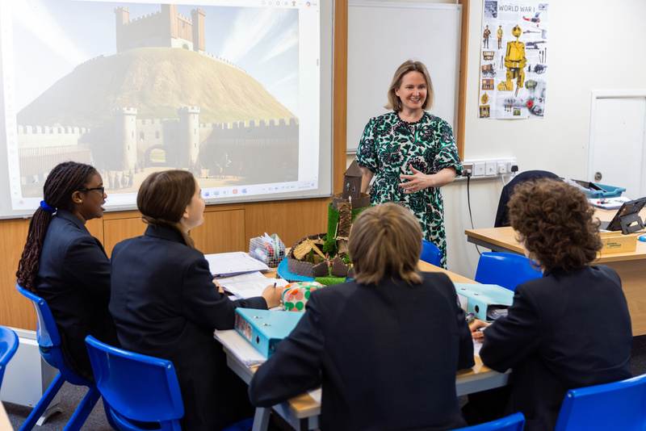
ETHOS & HERITAGE
Uniform is smart and sensible: navy blue blazer over white shirt (tartan tie for boys), tartan skirt or navy trousers. Sixth formers wear business dress.
Alumni include television presenter Sarah Beeny and actress and model Aiysha Hart. Strong alumni network creates ‘invaluable work experience and mentoring opportunities’, say parents.
Founded in 1918 by Bertha Drake, a religious woman, to provide a broad-based Christian education for girls (Christian principles remain – current logo incorporating symbolic cross for the letter y and recent appointment of full-time chaplain, though no on-site chapel). Various guises since - became Luckley-Oakfield in 1959 having merged with a Lake District school, Oakfield; rebranded to Luckley House School in 2013. Co-ed since 2015.
The sprawling campus boasts elegant tree-lined driveway and stunning green spaces, with wooden climbing frames and zipwire giving an adventure playground-feel. The main building, a charming Grade II listed country house, has a touch of period charm but no nasty draughts or rickety staircases. Warm and welcoming, with cosy log fire lit in winter, exposed oak beams and carpets you’d choose for your home. Other buildings more modern – including science wing and theatre with modern glass walls and computer suites elsewhere, giving students ‘the best of both worlds’.
Bustling canteen featured salad bar packed with fresh seafood and quiches alongside enormous portions of fish and chips. ‘You must try the chicken!’ students told us – quite right too as it was as delicious as the homemade chocolate eclairs. Three-weekly menu rotation influenced by student voice (katsu curry reinstated by popular request) and ‘cakes are a huge thing here’, students say proudly, with bake sales, ‘desserts from around the world’ and ‘doughnuts and discussion’ club spoken about with reverence. Parents say ‘it’s lovely to know they are so well-fed’.

Slide 11
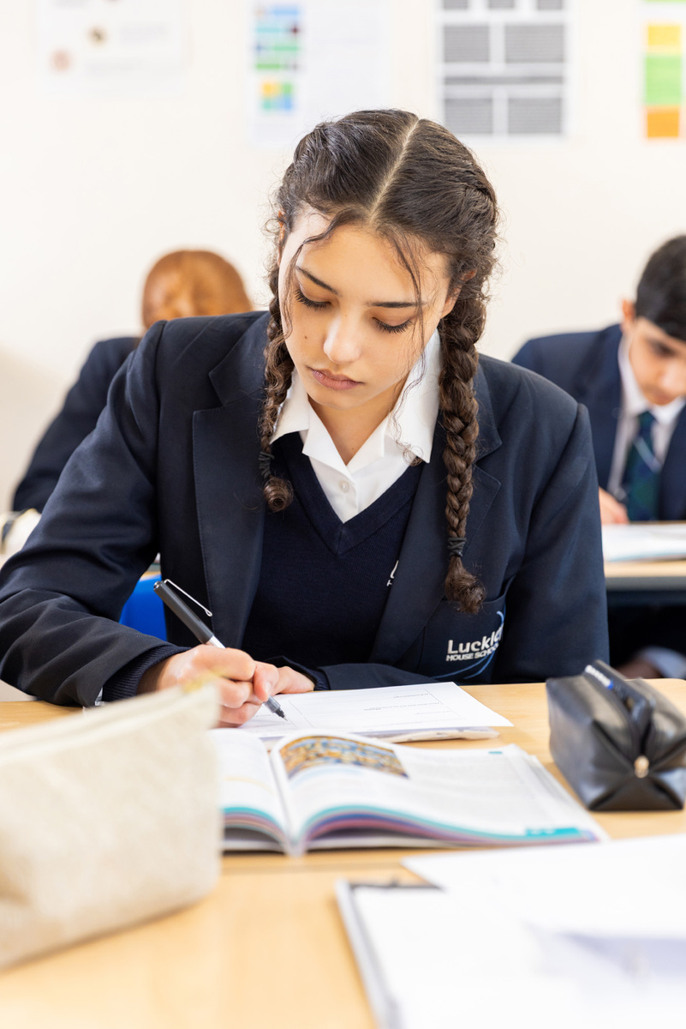
PASTORAL CARE, INCLUSIVITY & DISCIPLINE
MOBILE PHONE POLICY
‘Pastoral care is what Luckley does best,’ say parents, the ‘nurturing environment’ the first thing they all mentioned. Vertical tutor groups recently introduced, with the team of tutors ‘very popular’ – as are heads of sections (key stages) whose priority it is to ensure ‘children feel known’. ‘The bottom line is they are happy and we know they are safe,’ said one parent. Staff ‘email parents with any issues, with positive updates as well’, we are told, so parents feel involved and get ‘feedback on everything’. ‘Unbelievable support through personal challenges,’ added one.
Largely good behaviour, with some inevitable mishaps (the odd suspension, no permanent exclusions in memory). ‘Zero tolerance for bullying or derogatory language,’ says head. ‘Poor behaviour sticks out like a sore thumb here – children don’t like it’. Parents have noticed ‘an uptick in discipline and uniform regulations, especially skirt length’, with stern letters home for transgressions, but students describe the school as ‘friendly and fun’. Bullying is ‘not tolerated’, they say, with anonymous pupil portal to flag issues and a mentoring club where younger students can see year 13s for advice and support.
A clear mobile phone policy is a really important part of modern schooling. This school has provided us with their policy.
Years 7-9: Mobile devices must be switched off and put away into lockers by 8.45am, where they must remain until 4pm. They must not be kept in blazer pockets. At any other time, if it is necessary to contact.
This is ‘a tight knit community’ that’s ‘completely inclusive’, according to students – and we saw this for ourselves as sixth formers chatted kindly to younger years around the school. No diversity groups, including for LGBTQ+, neurodiversity or different cultures – unusual nowadays, but students are clear ‘everyone is welcome and can be themselves
here’. Culture and diversity weeks celebrated with international foods and flags and recent neurodiversity week featured talks that students say they found valuable.

Slide 12

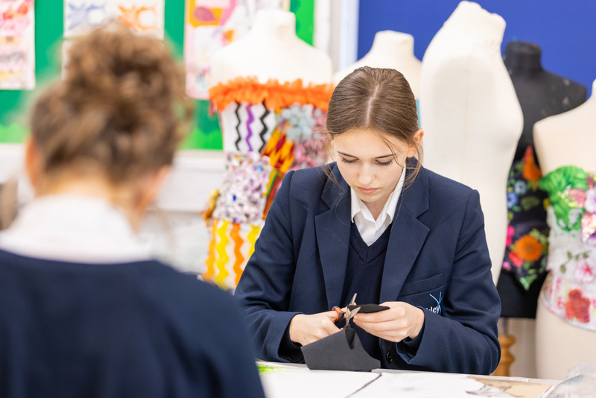
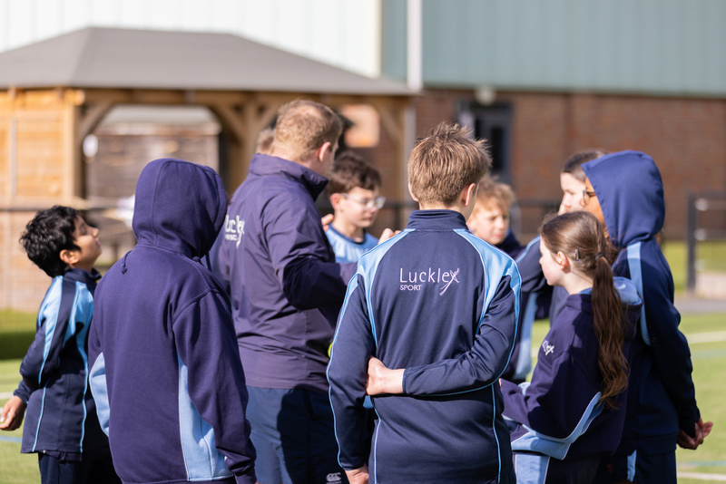
PARENTS & PUPILS
School transport routes cover Chobham, Camberley, Farnborough, Mortimer, Maidenhead, Bray, Windsor and Sonning, with private bus (at additional cost) offering morning and double evening services for enrichment activities. School says plenty of students walk and cycle 15-minute walk from Wokingham train station too. Driving ‘a nightmare’, we’re told, with ‘horrendous traffic and numerous roadworks in the area’ - parents appreciating early and late drop off for those affected to ease the pressure (breakfast and supper included!). Majority live within a 45-minute commute or board. Some grumble ‘logistical communication is not always as timely as it could be’ and would appreciate an overview of clubs ‘in advance of each term’.
Exceptional manners and warmth from the students we met, who were curious, polite and proud of their school. Majority white British, with international students ‘welcomed and well-integrated’. Students arguably less streetwise than in some schools – in the nicest way. One parent said her child who joined from a larger school noticed this too. ‘They initially found students immature but quickly realised they’re just kind and enjoying school – they didn’t know it could be this much fun being a teenager!’ Parents are mainly dual income families – ‘normal and down-to-earth,’ as one put it. All made welcome – ‘zero cliques’. ‘It’s a relatively small community and the year groups mix socially so everyone knows one another,’ as one pointed out – and there’s a strong PTA organising the usual events and second-hand shop.
MONEY MATTERS
Scholarships available at year 7, 9 and 12 for academics, art, drama, sport and music. Means-tested bursaries available. Ten per cent discount for siblings, children of armed forces or Foreign Office. Twenty-five per cent discount for full- time Christian workers.
THE LAST WORD
Large enough to offer breadth both in and out of the classroom and small enough to nurture the individual, Luckley House preserves the joy of childhood, creates community and balances flexibility with the high academic standards. The children love it.

